Slide 1
Preliminary results from HIJING++
2022.06.20
GPU DAY 2022
Balázs Majoros
Gábor Bíró
Gergely Gábor Barnaföldi
Gábor Papp

Slide 2
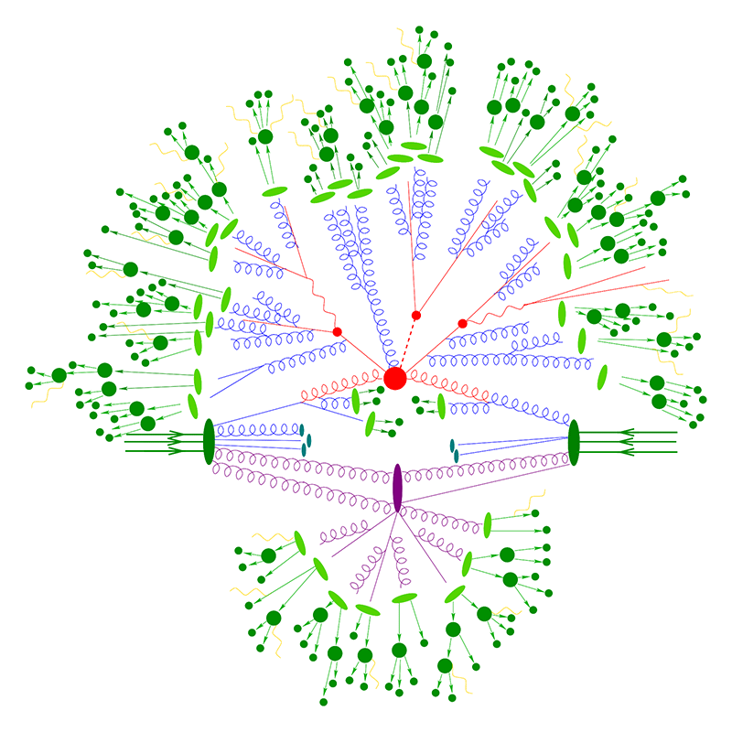
Why MCEGs important in HEP?
It provides detailed simulations of high-energy collisions
Monte Carlo event generators are widely used by theorists and the experimental community
Used in data analysis, designing new experiments
And to make predictions, and put our models to test
Computationally expensive
In order to get good statistics it needs to run for days or weeks

Slide 3
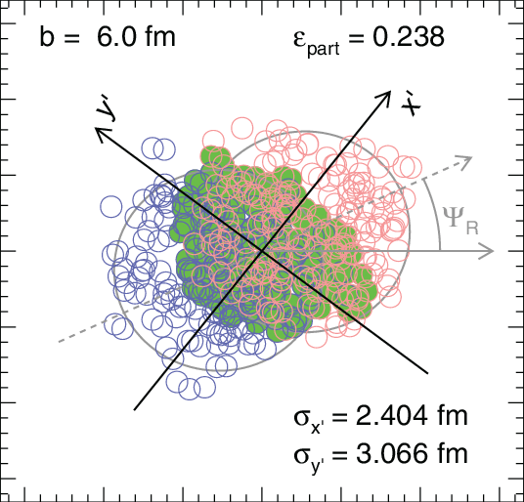
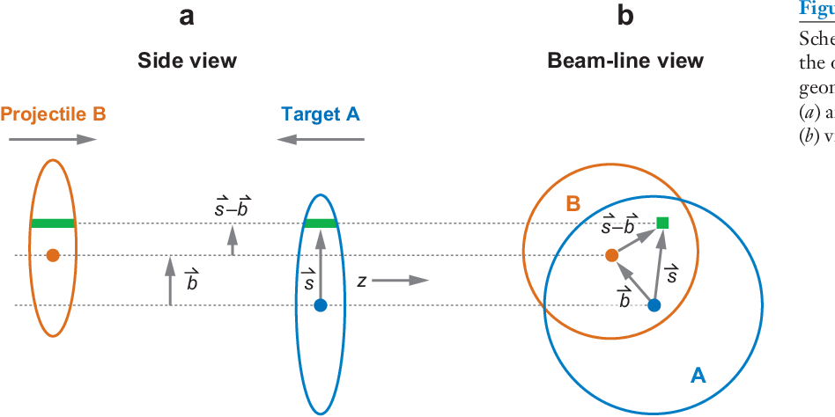
HIJING++
Monte Carlo Event Generator for proton-proton and heavy-ion collisions (pre-release) Heavy Ion Jet Interaction Generator
Successor of the old Fortran HIJING, rewritten in C++
Support for CPU multithreading
The output depends on several internal parameters
We had to examine around 40 physical parameters
For one system it's a relatively easy task
But we have to find a working combination for a range of energies from 20 GeV to 13 TeV in p-p, p-A, A-A collisions

Slide 4
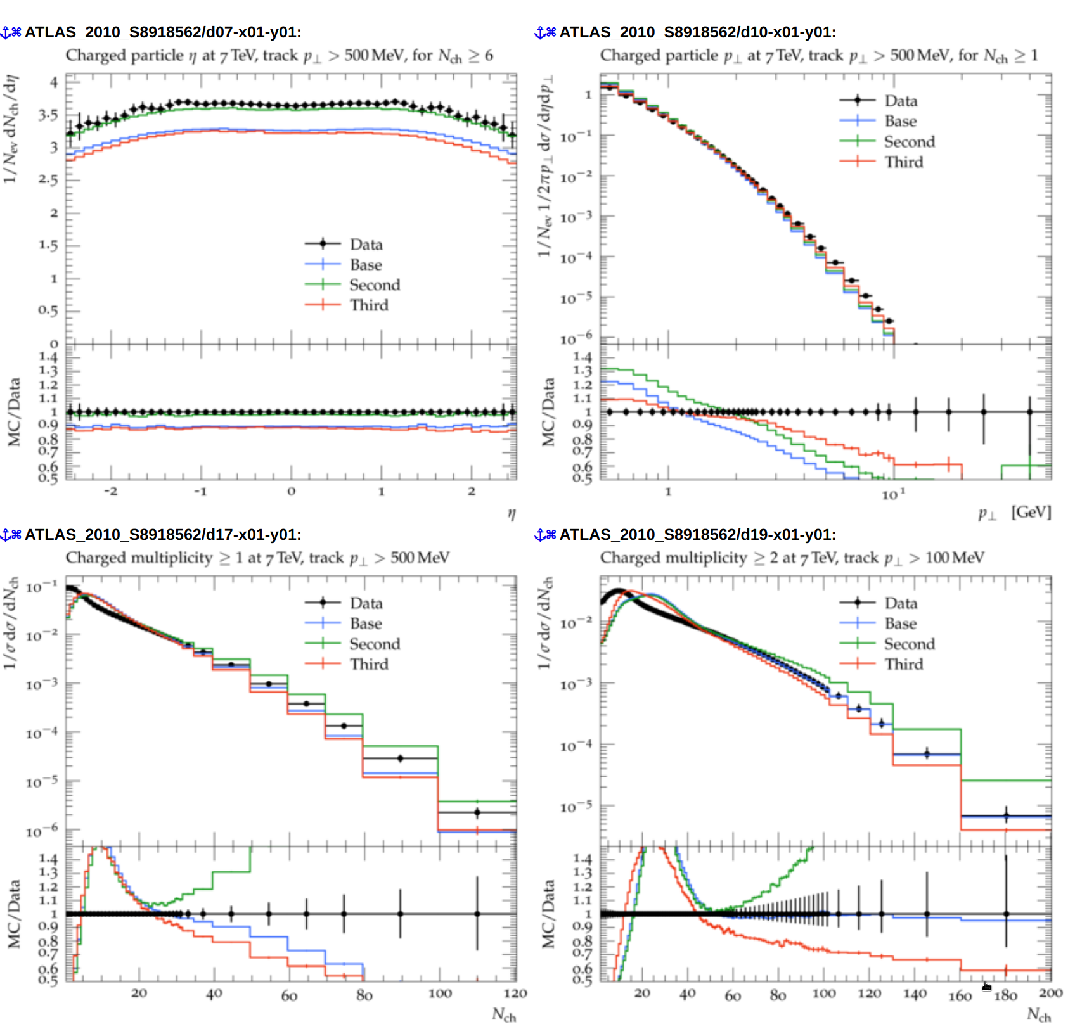
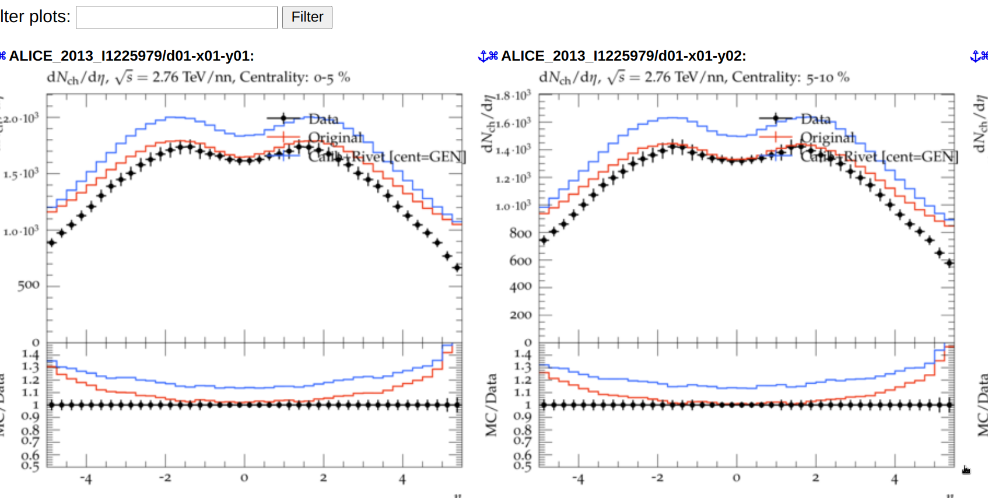
Statistics
Simulations take place in HPC clusters provided by the Wigner Data Center ^{[1]}
7 nodes with 16 core Intel Skylake CPU-s and 32 GB RAM
5 TB Disk space
In almost a year (a rough estimate):
30 000 HIJING++ runs
Generated ~500 TB of data
In around half a year of CPU time
And we need even MORE...

Slide 5
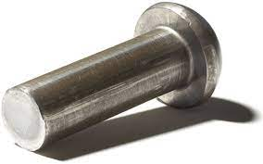
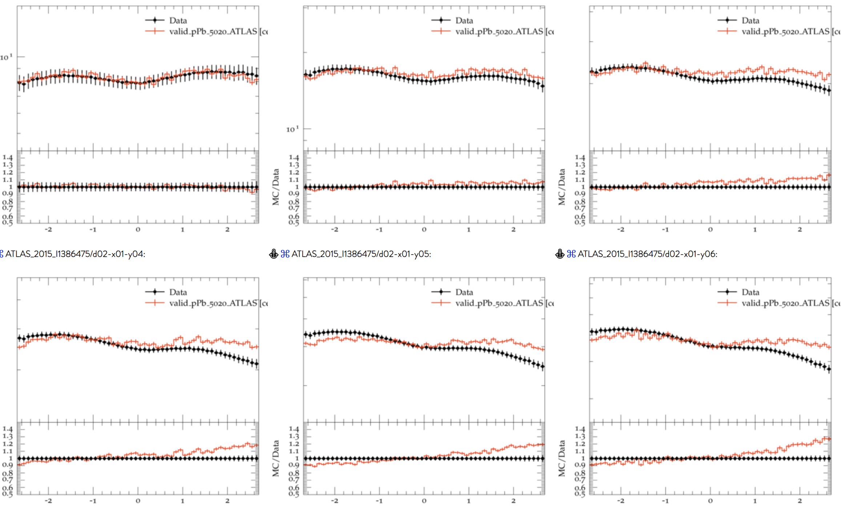
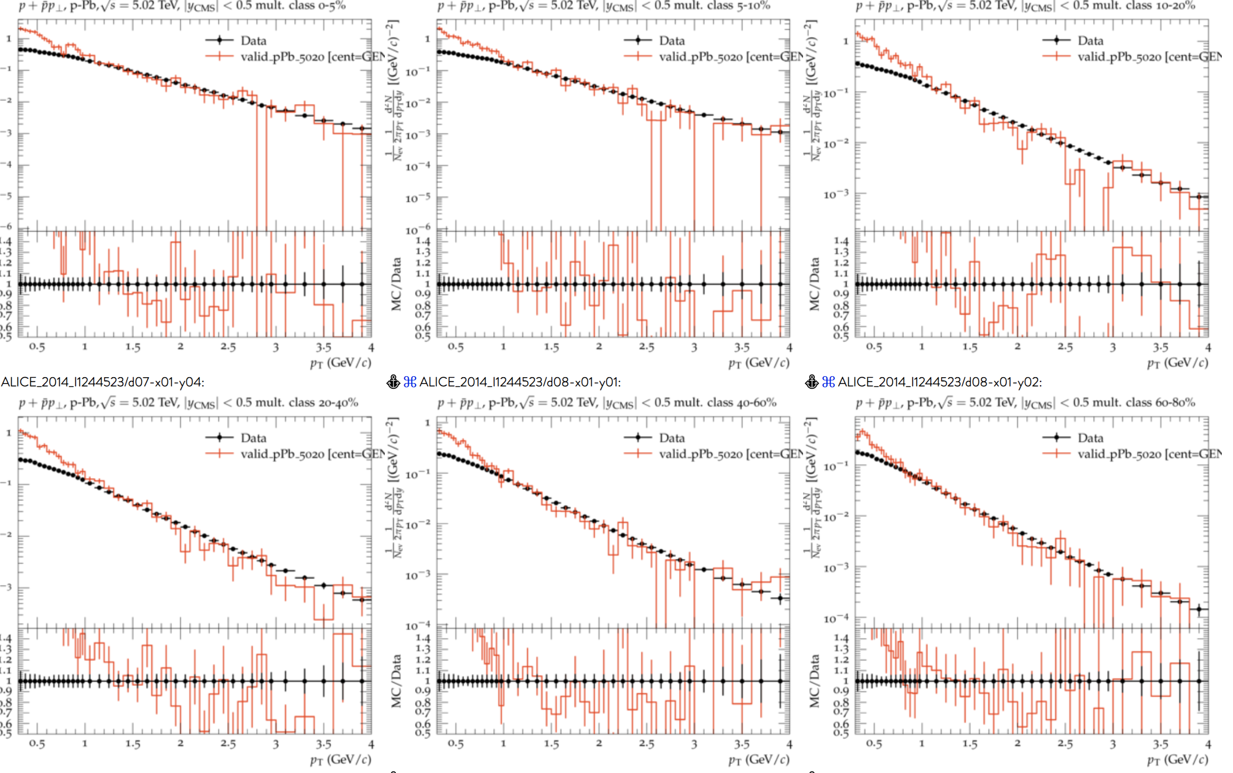
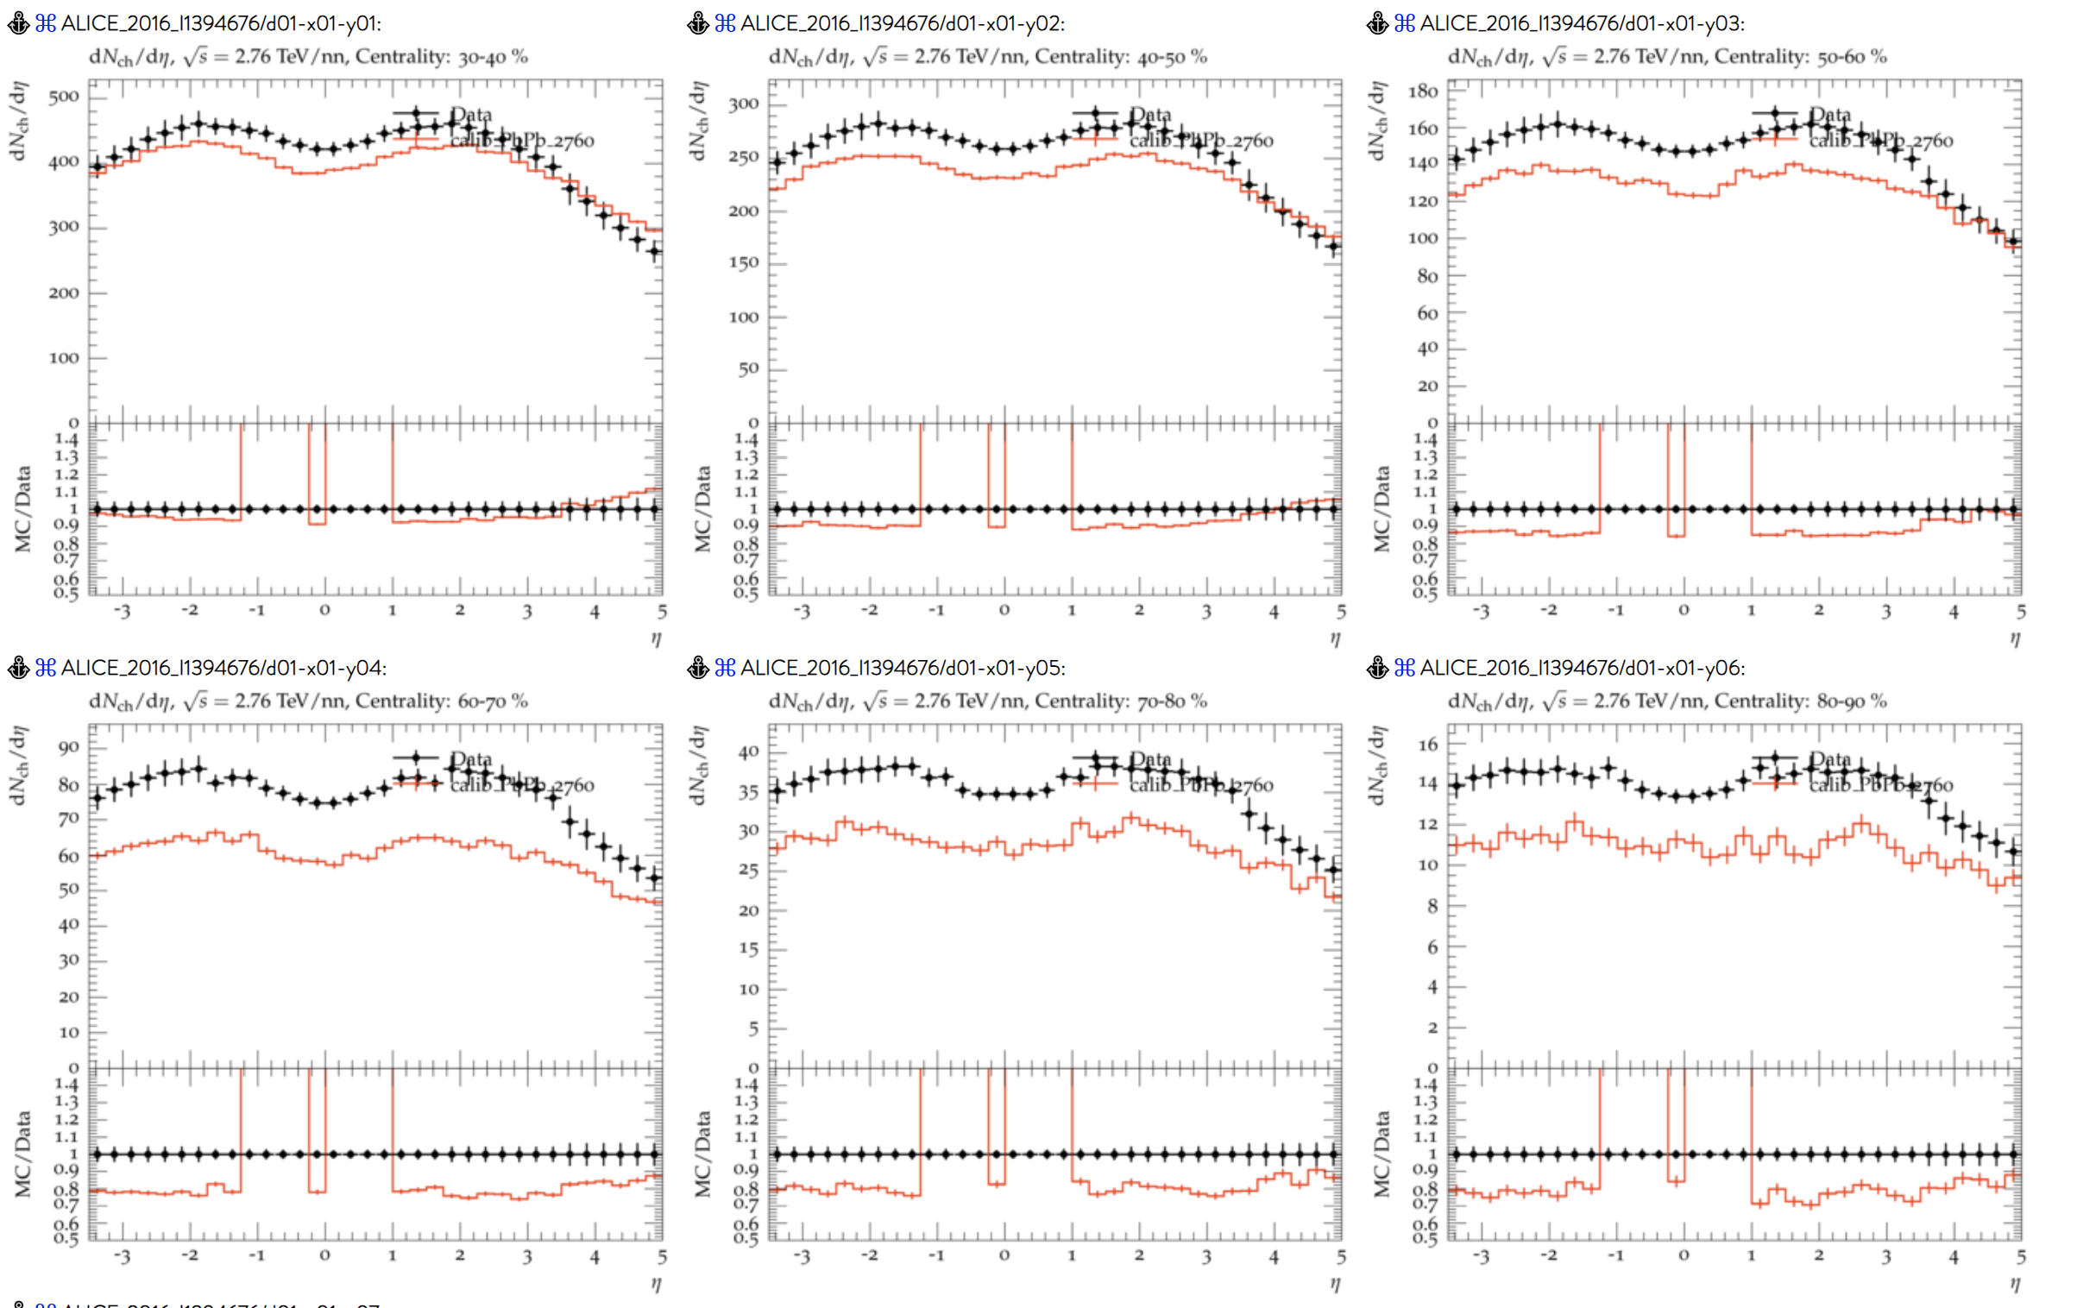
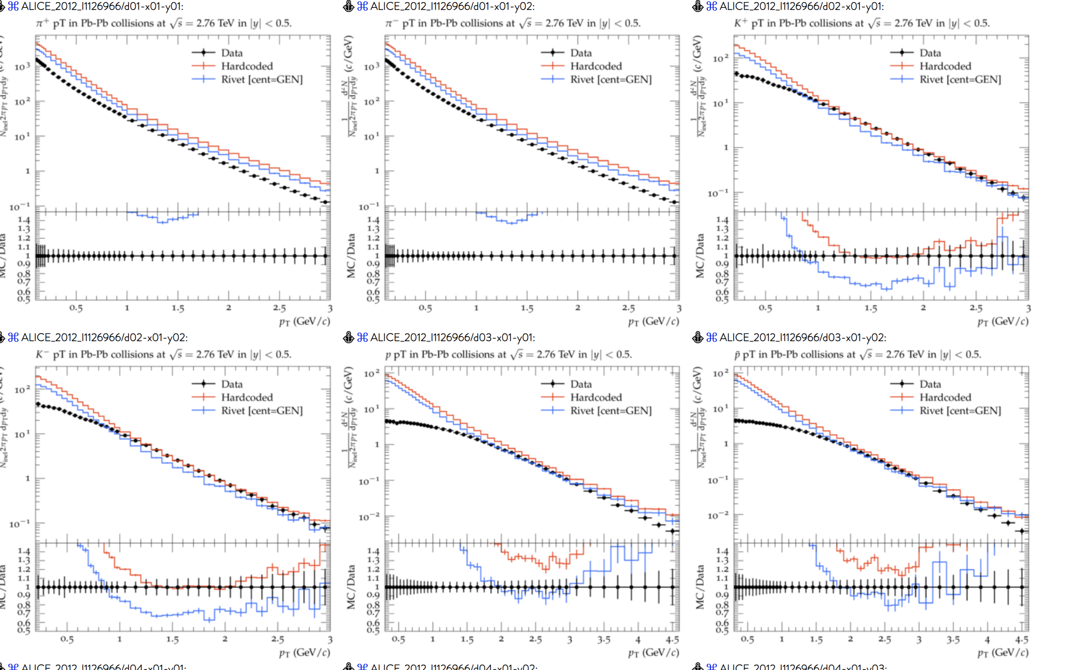
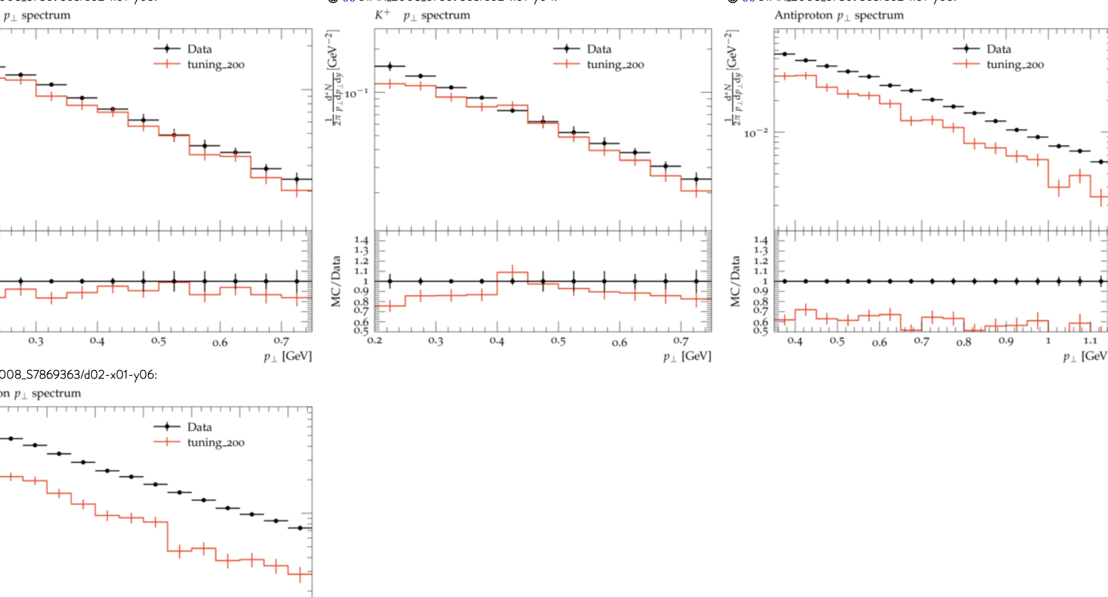
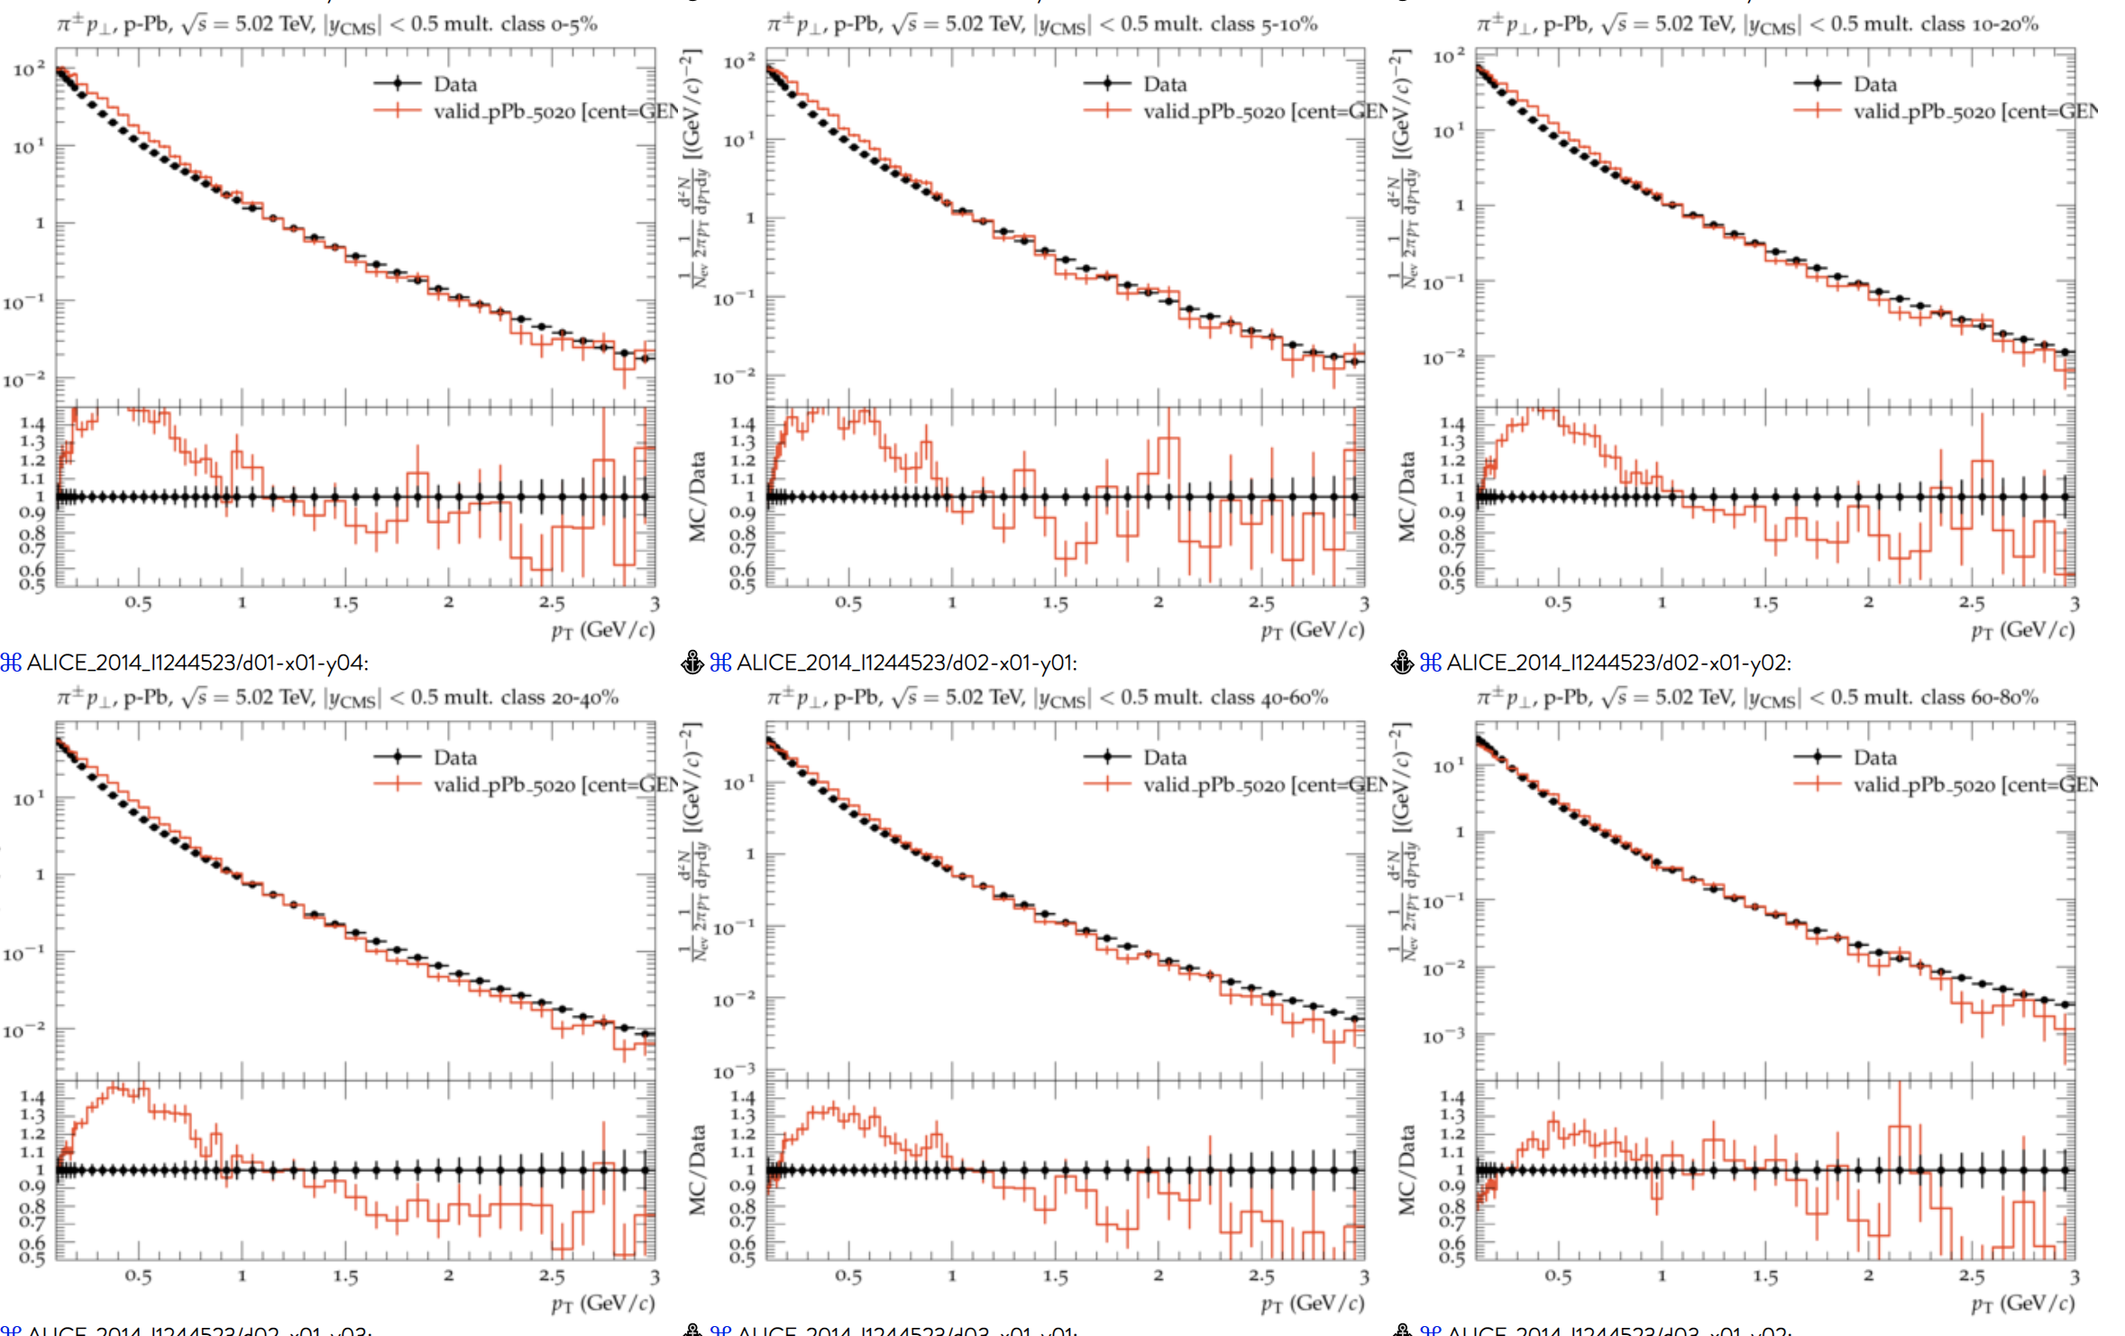
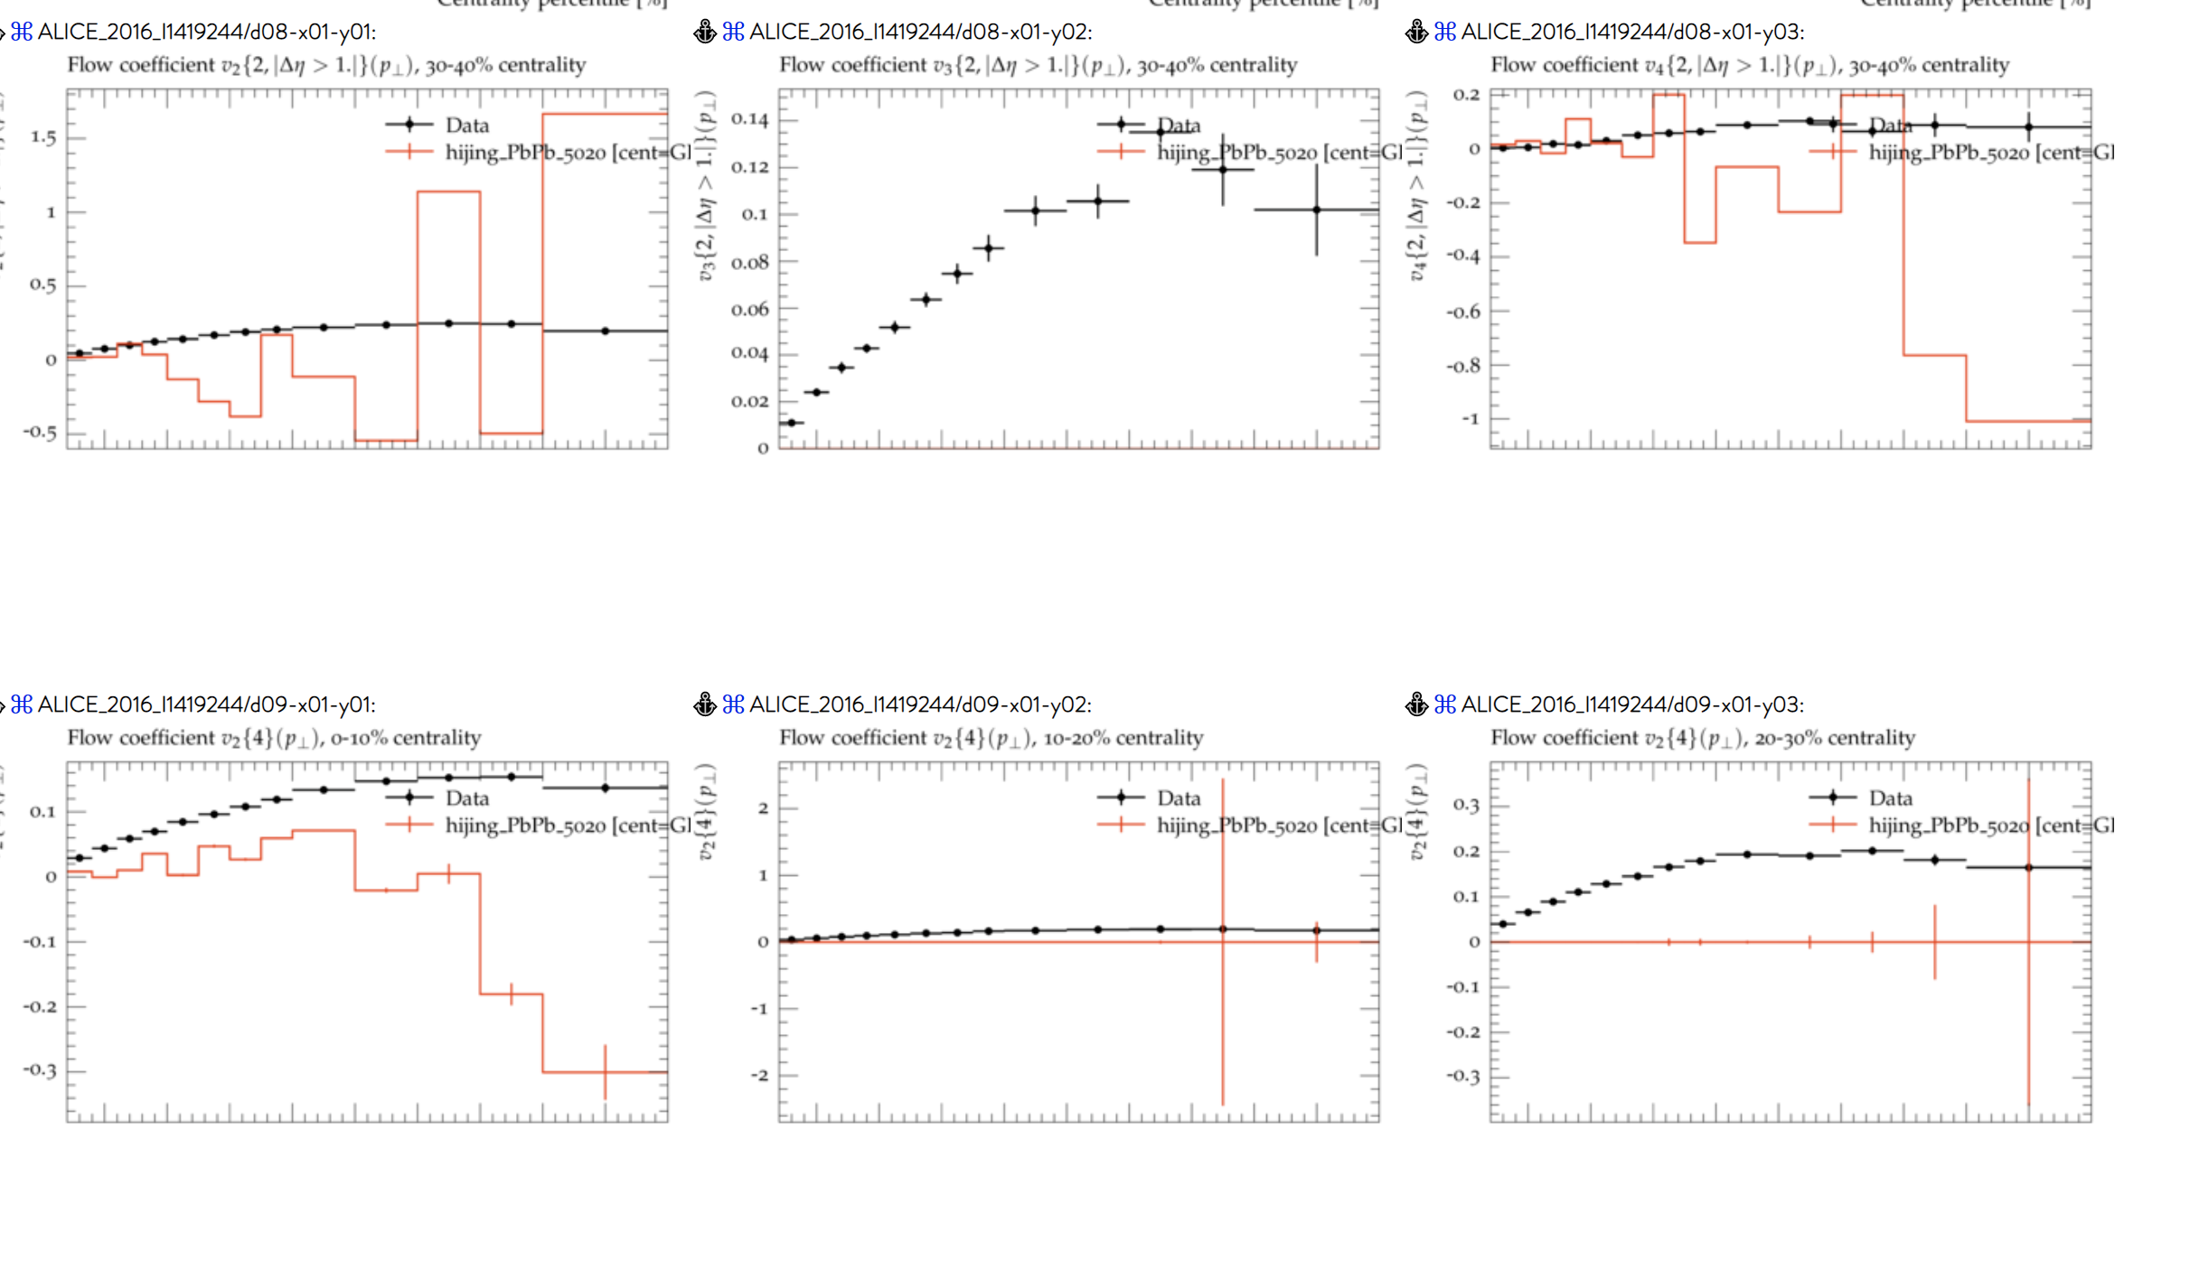
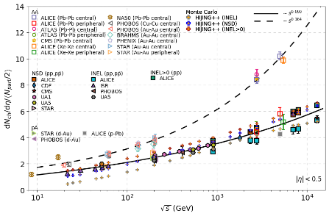
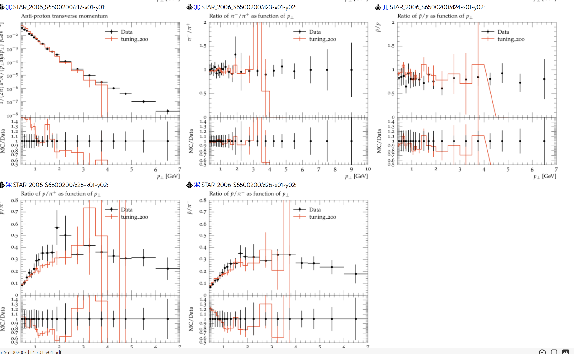
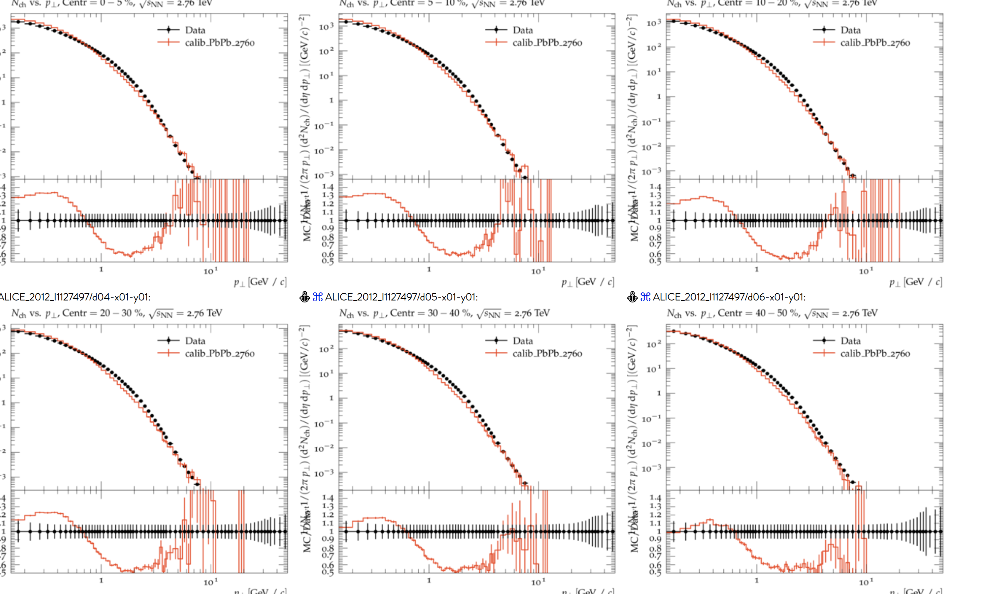
Tools for the tuning
Stack:
Rivet toolkit^{[2]} (Robust Independent Validation of Experiment and Theory)
YODA ^{[3]} (Yet more Objects for Data Analysis)
Professor ^{[4]}
HIJING++ (Heavy Ion Jet INteraction Generator)
Notes:
Rivet allows us to build

Slide 6
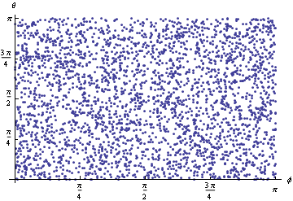
Tuning process
Sampling the parameter space
Preparation
Simulating HIJING++ in HPC Clusters
Node1
Node2
Validating
Node4
Node3
Tuning with Professor
Notes:
Rivet allows us to build

Slide 7
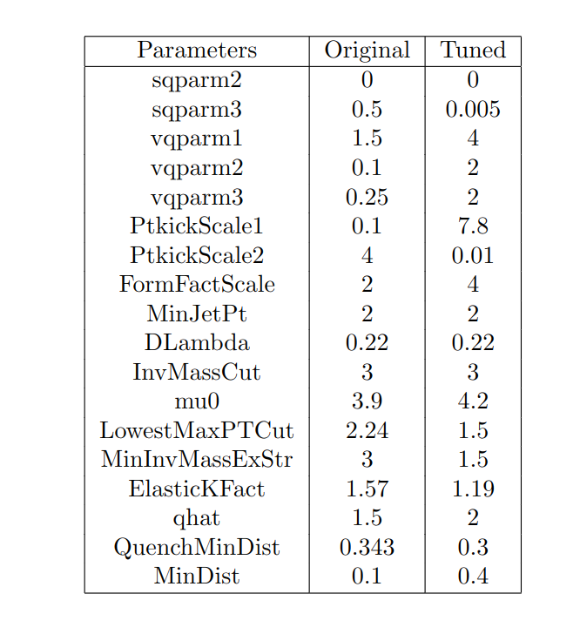
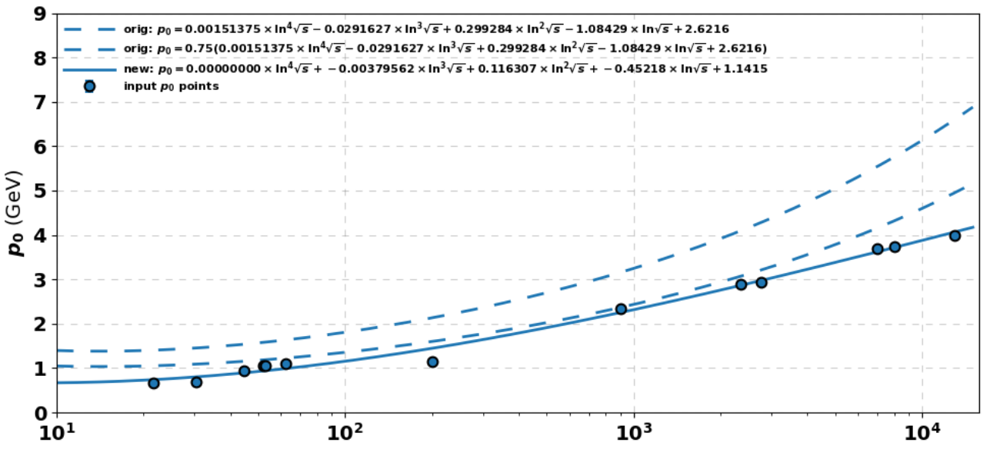
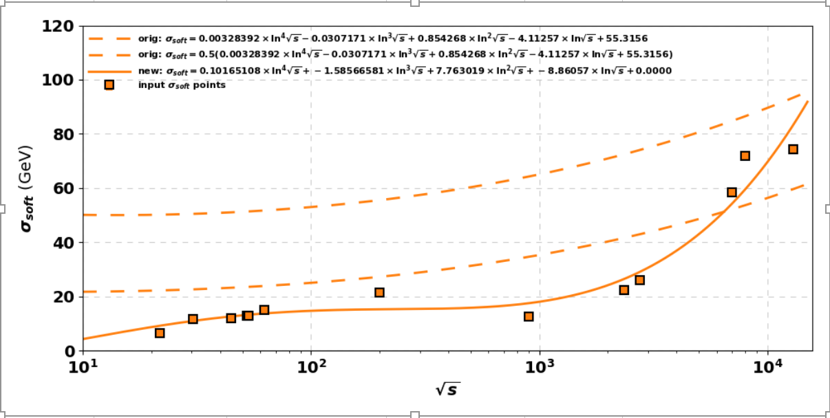
Tuning results
After around 100 iteration of the last „cycle” we settled on some of the parameters
The results can always be improved
But with our tune now the HIJING++ now in all systems at RHIC and LHC energies will provide a „good” fit to the experimental data
Notes:
Rivet allows us to build

Slide 8
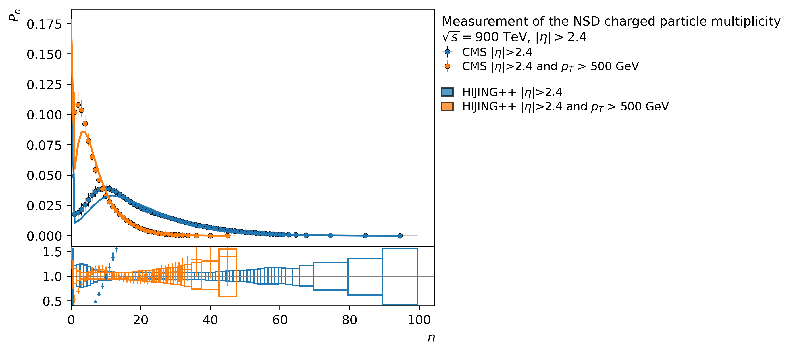
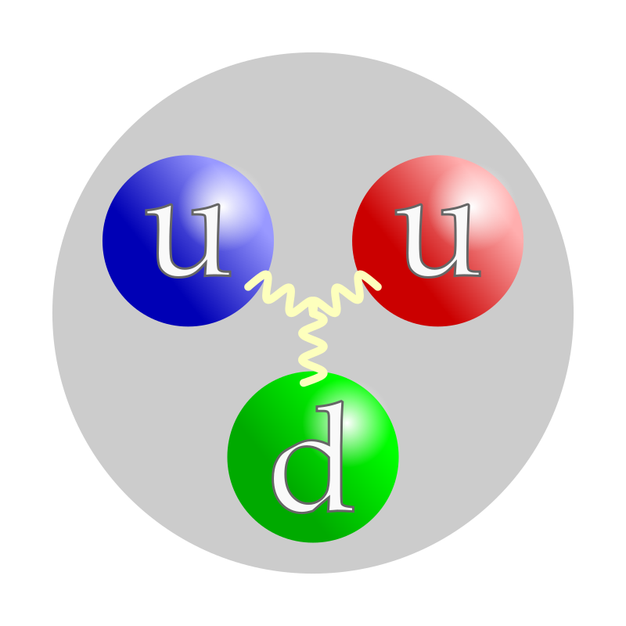
HIJING++: CMS proton-proton collision Measurements of primary charged hadron multiplicity distributions are presented for non-single-diffractive events in proton-proton collisions at centre-of-mass energies of 0.9 TeV
link

Slide 9
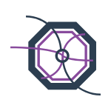
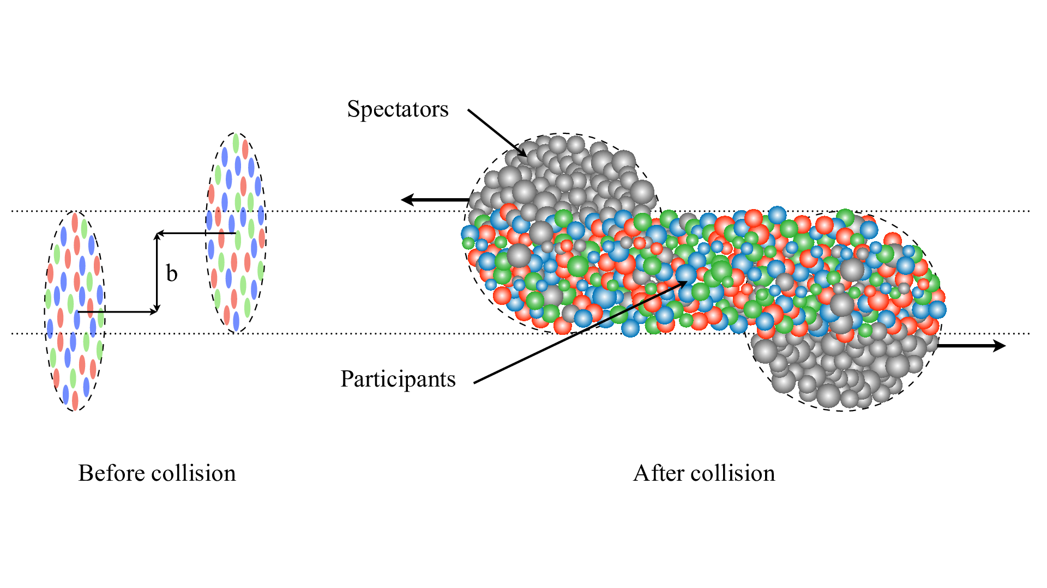
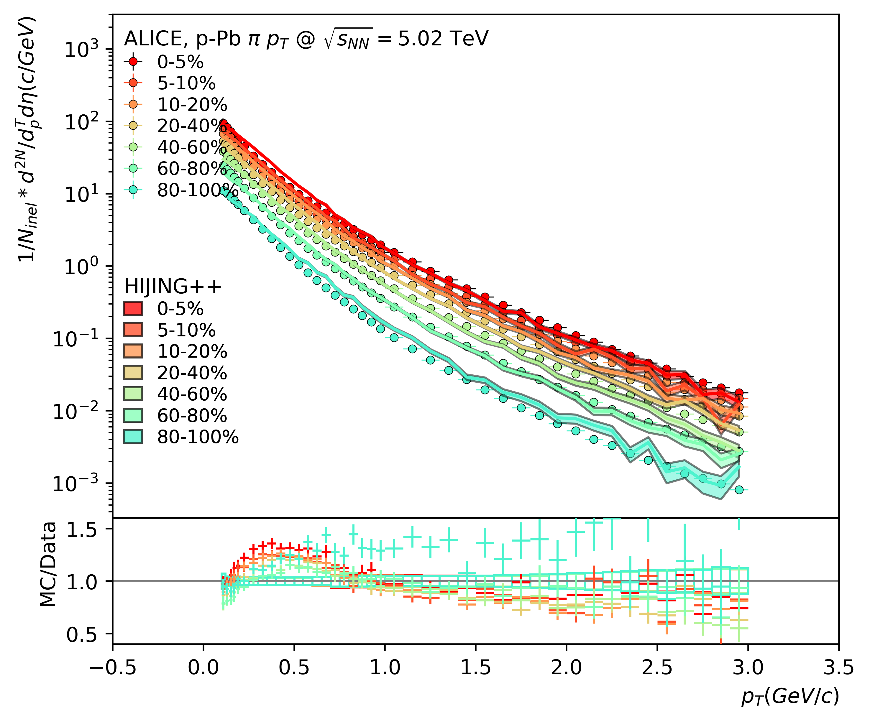
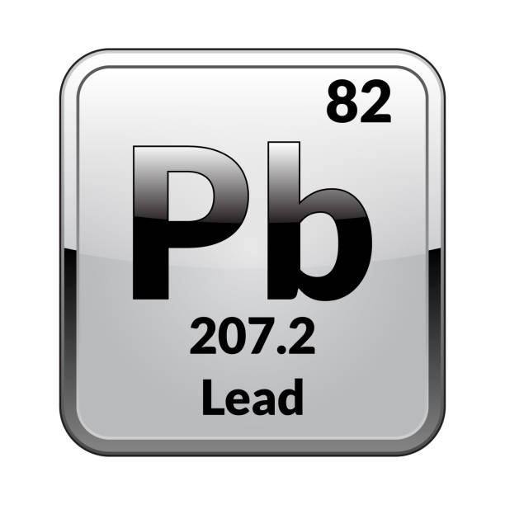
HIJING++: ALICE proton-Lead collision at 5.02 TeV Pion pT spectra at seven centrality classes
link
Centrality: 0-5%
Centrality: 80-100%

Slide 10
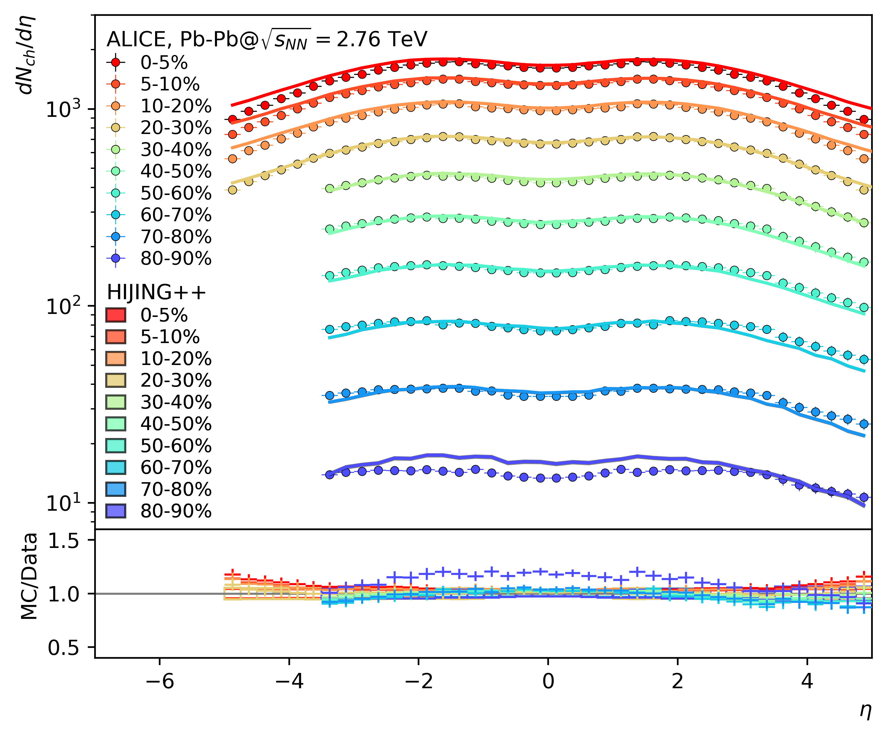
HIJING++: ALICE Lead-Lead collision at 2.76 TeV Charged particle pseudorapidity density in centrality classes
link
Centrality: 0-5%
Centrality: 80-100%

Slide 11
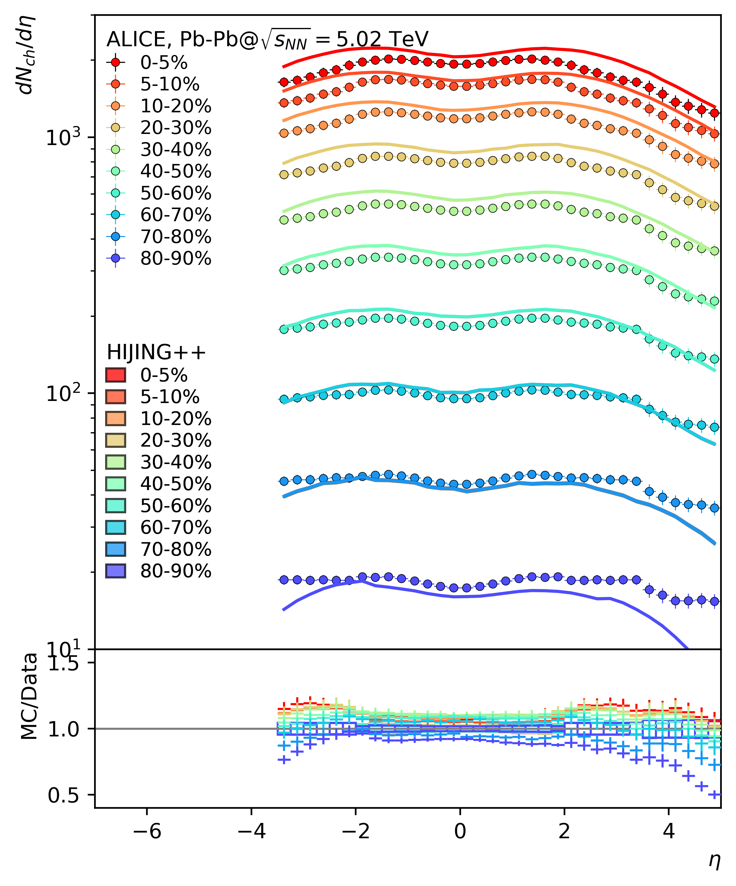
HIJING++: ALICE Lead-Lead collision at 5.02 TeV Charged particle pseudorapidity density in nine centrality classes
central
perif
Centrality: 0-5%
Centrality: 80-100%

Slide 12
Summary
The tuning step of the HIJING++ is now finished (for now)
There are promising results and currently we are in the stage of gathering data and publishing the results.
Near future plans include:
Make the project open source
Implement GPU paralelization for calculations
Stay tuned! (no pun intended)
Notes:
Rivet allows us to build

Slide 13
Special thanks to:
Wigner GPU Laboratory
Wigner Data Center
Thank You for the attention!
The research was funded by K135515, 2019-2.1.6-NEMZKI-2019-00011
2020-2.1.1-ED-00179
References:
^{[1]} https://wignerdc.wigner.hu/home
^{[2]} https://rivet.hepforge.org
^{[3]} https://yoda.hepforge.org
^{[4]} https://professor.hepforge.org

